Slide 1
CCDC Final Brief

Slide 2
Agenda
Mission
All teams cover: Responsibility matrix, progress made, deliverable description, progress needed
Monitoring
Services
Systems
Networking
Strike
Pitfalls
Recommendations for Next Year
Plan till Qualifiers
Final Team
Questions

Slide 3
Mission
To educate, train, and prepare the USMA Collegiate Cyber Defense Competition team for the Collegiate Cyber Defense Qualifier on 27 January 2018 in order to advance as a team to Regionals in the spring and create the foundation for future teams.

Slide 4
Monitoring Team - Responsibility Matrix
Cannon- Linux
Monitoring linux logs with centralized server and clients
Clients forward info to server for easier reading of entire network
Overwatch of security features
Extra information on checklist to show how to monitor data communications
Walsh- Windows
Monitoring Windows logs
Use of Event Logging API for Windows 2000, XP, and 2003
Use of Windows Event Log from Vista-Win10
Use ECManGen.exe to create instrumentation manifest
Use of SNORT and Windows Defender

Slide 5
Monitoring Team - Deliverable Information
Progress made
Created Checklist for both Linux and Windows to monitor each system
Rsyslog service
Windows event logging/Windows defender
Main Takeaways
Linux Monitoring services require server and client
Windows monitoring requires preset functions and code
Both advanced and simple ways to set up each monitoring service
Checklists can me made more in depth if needed (using web server/email)
Work needed
Further testing and validation of checklists/work with services to learn what each pitfall is in order to monitor the entire network better
Decide who will be operating both linux and windows monitoring
Since there is only 8 person team

Slide 6
Services Team - Responsibility Matrix
Jaryn Villegas (Team Leader):
HTTP/HTTPS, SMTP
Jayleene Perez:
SSH, DNS
Al Wilton:
FTP, MySQL
Gabe Glazer (CCDC Assistant Team Leader):
AD/LDAP

Slide 7
Services Team - Deliverable Information
Progress made
Checklists created to harden services:
Clear, concise instructions
Main takeaways
Identify what you are working with
Assess the issues
Fix them
Additional security measures
Work needed
Validation of checklists
Person to work this part during competition

Slide 8
Systems Team - Responsibility Matrix
Cole Kunze:
Windows Server 2000 & Specific Linux versions (Ubuntu, Fedora, Red Hat, CentOS)
Jake O’neill:
Windows XP, 7, and 10
Alex Gelashvili:
Linux baseline

Slide 9
Systems Team - Deliverable Information
Progress made
Linux and its supplemental checklists complete
Windows 2000 complete--translates to later versions
Windows XP, 7, and 10 checklists complete
Main Takeaways
Windows VMs arrive very insecure
Linux has efficient, built-in security
Work needed
Expand on SELinux
Explain the small differences between Windows Server 2000 and later versions

Slide 10
Networking Team - Responsibility Matrix
Alex Soler (Team Leader): Firewall
Windows Server 2012/2016
Windows Vista/7/8/10
Linux UFW/iptables
Gabe Yarbrough: Routing
Cisco Routers
Cisco Switches
Gabe Bann: Proxies
AnalogX - Windows
Squid - Linux

Slide 11
Networking Team - Deliverable Information
Progress made
Researched proxies and gained familiarity with different access control measures
Created checklists
Cisco Switch & Routers
Windows Server 2012/2016 Firewall
UFW and iptables for Linux
Windows Firewall for Users
Windows and Linux Proxies
Main Takeaways
Networking Team must be proficient in networking fundamentals
Access Lists and Firewall Rules will change on a case by case basis
Work needed
Juniper Router Research (If we make it past the initial cut)
Practice with setting up “secure” networks
Active Directory familiarity
Fix Checklists

Slide 12
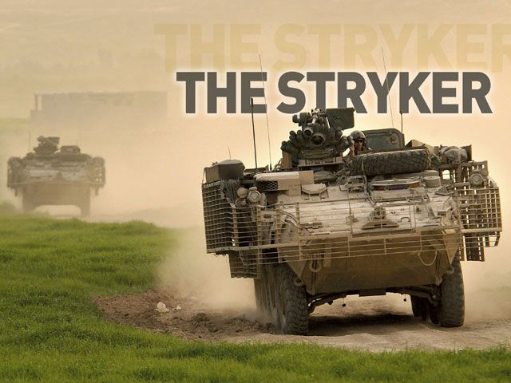
Strike Team - Responsibility Matrix
Nikolay Shopov (Team Leader): Volatile Memory, Malware
Wireshark
Volatility
Chkrootkit
AnalyzeMTF
Alex Gelashvili: Initial System Vulnerability Scan
OpenVAS
Lynis
Microsoft Baseline Security Analyzer
Gabe Bann: Network Scanning
Nmap

Slide 13
Strike Team - Deliverable Information
Progress made
Researched ways to do an initial vulnerability scan on Linux and Windows machines.
Microsoft Baseline Security Analyzer, Lynis
Look into Volatile Memory Analysis and ways to do a memory dump and do forensics on it.
Gather network packets with Wireshark/Nmap and do Incident Handling
Explore possible scans for Malware and File Carving
Main Takeaways
Team focus is on initial vulnerabilities scan and identification of possible weaknesses of the system
Scanning the network and capturing packets is key in figuring what was the breach
Having a Malware detector (antivirus) is not that useful due to many custom made exploits
Work needed
Expand the instructions with more tips and find alternative programs
Find out more on how to do memory dump

Slide 14
Project Pitfalls
Started late
Disorganized in the beginning
Initial lack of clear understanding of cadet responsibilities
Did not inherit network
AWS config files
Some course work didn’t apply to CCDC
Short time frame in which to work

Slide 15
Recommendations for Next Year
CCDC needs to be a semester long class.
Recruit second semester cow year
CCDC semester long class
Selected cadets move forward and compete second semester firstie year
Long term way to pay for AWS (Grant?)
Required prerequisites (IT350, IT392, IT460)
More guidance towards some of the requirements (make labs for each part of the competition)
Lay out what the checklists needs to be, seems like confusion across the board on what is required
Practice more with already in place machines rather than setting up our own
Practice being a blue team, finding the adversary
More work among the entire class, everyone sets up their own systems without knowledge of what others are doing even though we all need to work in tandem during the competition.

Slide 16
Moving Forward
Date | What
NLT 27 DEC | Stand up own final checklist on AWS (Seth birthday)
NLT 28 DEC | Review how to handle possible injects (on Trello Card)
NLT 29 DEC | Review LDAP, AD, Firewall checklist
NLT 01 JAN | Stand up LDAP, AD, Firewall checklist
NLT 03 JAN | Bring back top 3 checklist you feel comfortable with
08 JAN | Monitoring/WireShark/TCP dump lesson
10 JAN | Monitoring/WireShark/TCP dump practice
17 JAN | Palo Alto Network/Networking lesson
22 JAN | Palo Alto Network/Networking practice

Slide 17
Moving Forward Continued
24 JAN | Conditions Check (identifying weaknesses)
26 JAN | Final Review
27 JAN | CCDC Qualifier Happy Birthday LTC Moody (42)

Slide 18
Next Semester Team
Seth Cannon
Pat Walsh
Bradley Cho
Gabriel Yarbrough
Nikolay Shopov
Aleksandre Gelashvili
Jaryn Villegas
Alexander Soler
Jayleene Perez
Gabriel Bann
Gabriel Glazer

Slide 19
Questions

